Slide 1


Presented by Abhishek Roy
Finding the Niche: A Data-Driven Strategy for a New Sustainable Fashion Brand
Strategic Analysis & Recommendations

Slide 2

The Challenge: Entering a Crowded Market
How can a new, ethical brand succeed in a market dominated by fast fashion?
Our task is to use data to find a viable market niche and a compelling value proposition.

Slide 3
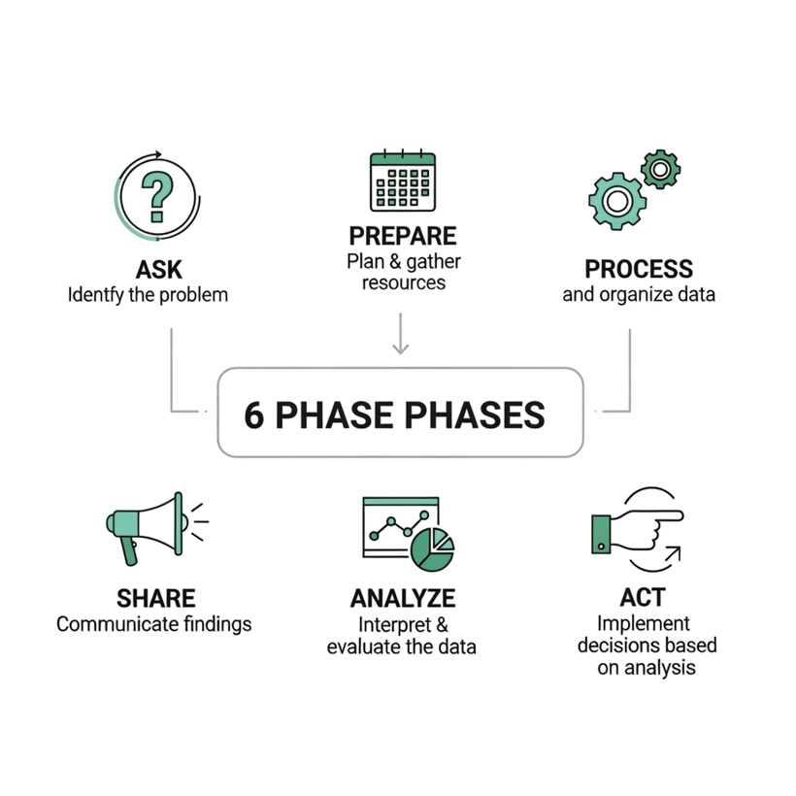
From Data to Decisions
A structured 6-step analysis process has been followed to ensure our recommendations are built on a solid foundation.

Slide 4
The Right Data for Our Business Question
The Right Data for Our Business Question
Dataset: "The True Cost of Fast Fashion Impact" (Source: Kaggle*)
01.
02.
03.
Comprehensive: Includes the major fast-fashion players needed for a relevant competitive analysis.
Dual-Focus: Contains both economic metrics (like Price and Volume) and crucial sustainability metrics (like Waste and Carbon Emissions).
Actionable: This unique combination allows us to create "per-item" impact scores, enabling a fair and direct comparison between brands of different sizes.

Slide 5
Our Analytical Toolkit: Using the Right Tool for the Job
MySQL | Excel | RStudio | Tableau
What: A robust database for storing and managing data. | What: A spreadsheet tool for initial data inspection. | What: A powerful environment for statistical analysis. | What: A leading platform for data visualization and storytelling.
How: Used to house our central dataset, perform data cleaning, and create new "per-item" metrics. | How: Used for a quick visual scan of the raw CSV file to check for formatting issues before importing. | How: Used to perform descriptive statistics and correlation analysis to validate our findings. | How: Used to create the interactive bar chart and the strategic scatter plot.
Why: Provided a reliable and queryable single source of truth for the project. | Why: Perfect for a fast, initial check without complex setup. | Why: Its statistical functions allowed us to prove our findings were significant. | Why: The best tool for translating complex data into a clear and compelling visual story.

Slide 6
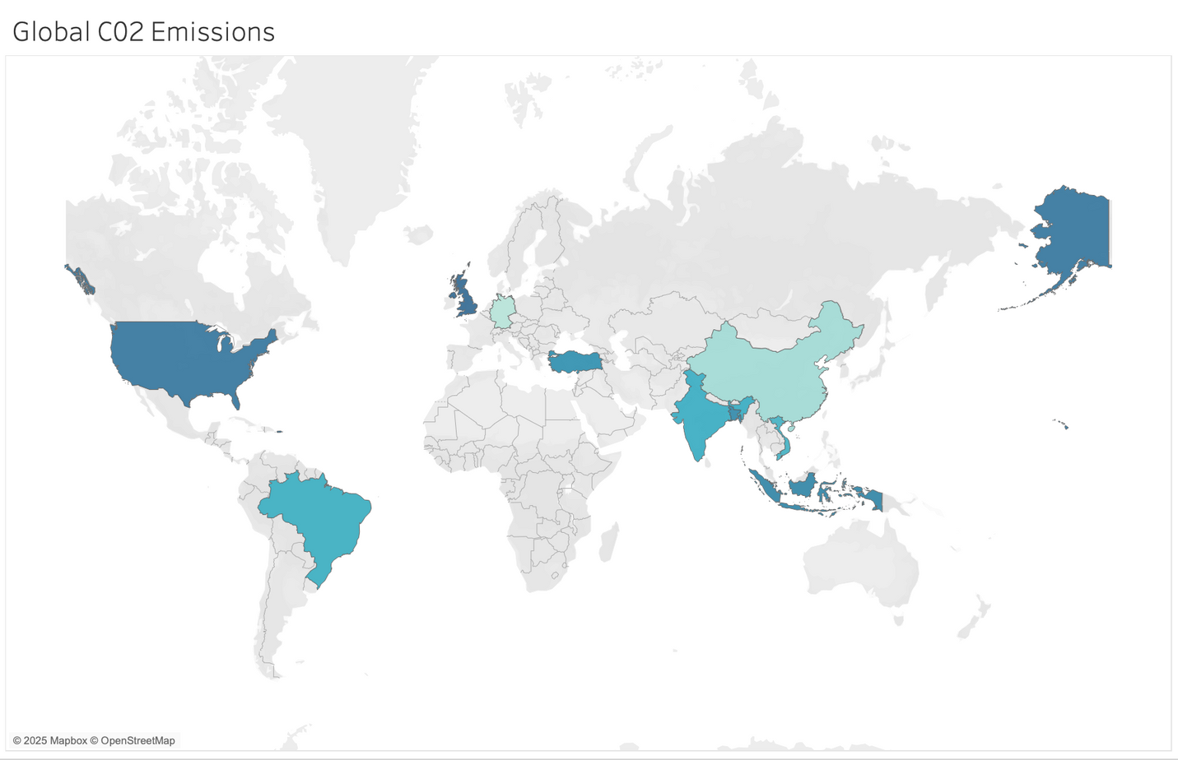
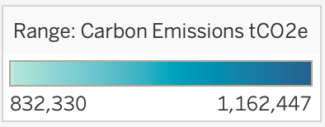
A Global Issue: The Footprint of Fast Fashion
The environmental impact of fast fashion isn't localized. Our data shows significant carbon emissions originating from key production hubs across the globe, highlighting the worldwide scale of the problem.

Slide 7
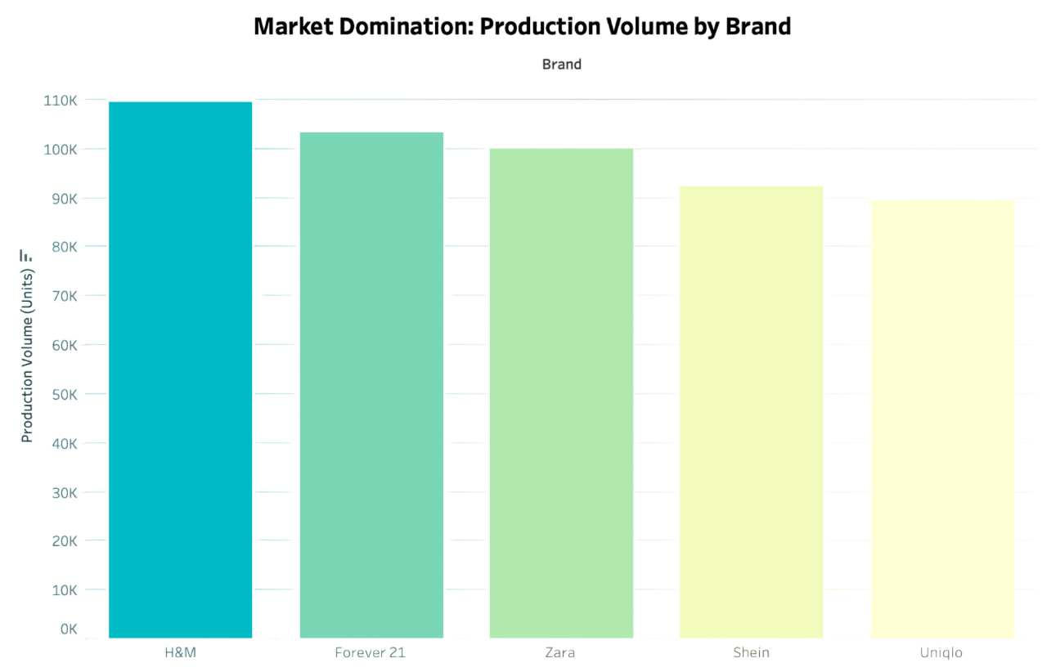
The Market is Dominated by a Few Mega-Producers
Competing on volume and price is not a viable strategy for a new entrant.

Slide 8
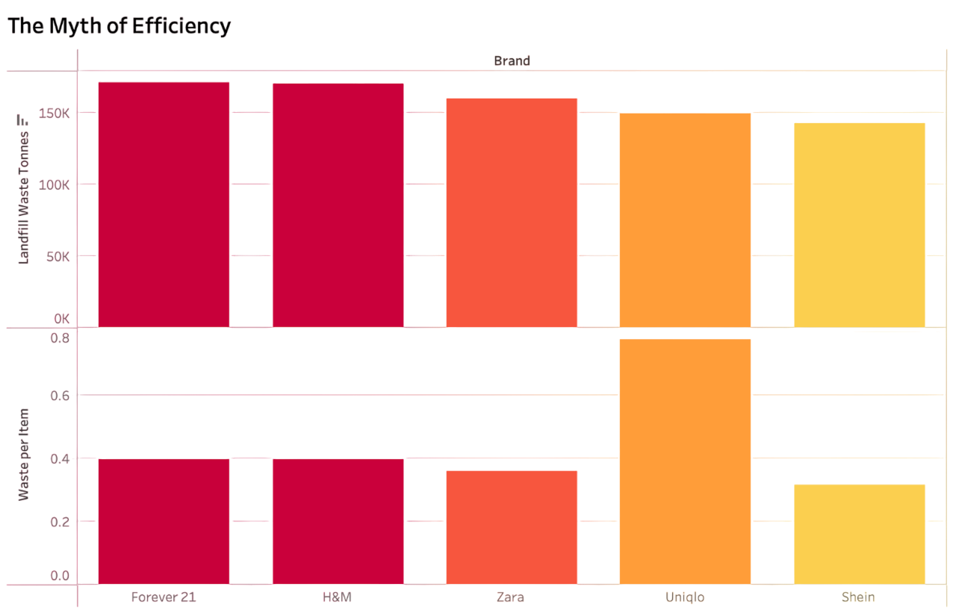
Low Price Doesn't Mean Low Waste
Looking at total waste alone is misleading. To understand true efficiency, we must analyze the waste generated for each item produced.

Slide 9
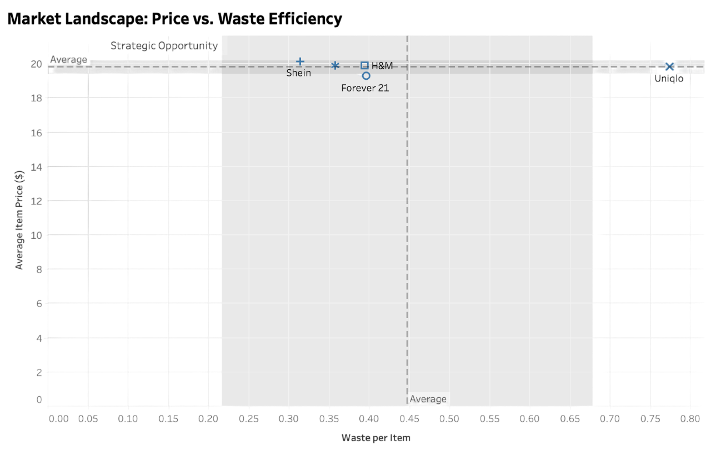
Mapping the Market: Price vs. Waste Efficiency
A clear gap exists for brands that offer low waste at a moderate price point.

Slide 10




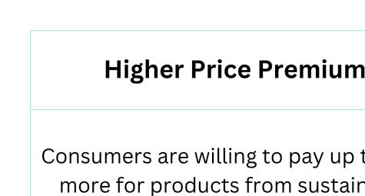

Why Sustainability is Profitable?
Sustainability is Not Just a Cost, It's a Competitive Advantage
Investing in sustainability directly translates to higher revenue, stronger customer relationships,
and improved operational efficiency, creating a powerful financial incentive for new companies
to adopt these practices from day one.

Slide 11

Presented by Abhishek Roy
Thank you very much!

Slide 12
References
Data Source:
"The True Cost of Fast Fashion Impact" - Kaggle.com
Industry Reports & Market Research:
NielsenIQ (2021). Sustainability & Consumer Behavior Report
McKinsey & Company (2023). The State of Fashion 2024
Boston Consulting Group (BCG) & Global Fashion Agenda (2022). Fashion on Climate

